Slide 1
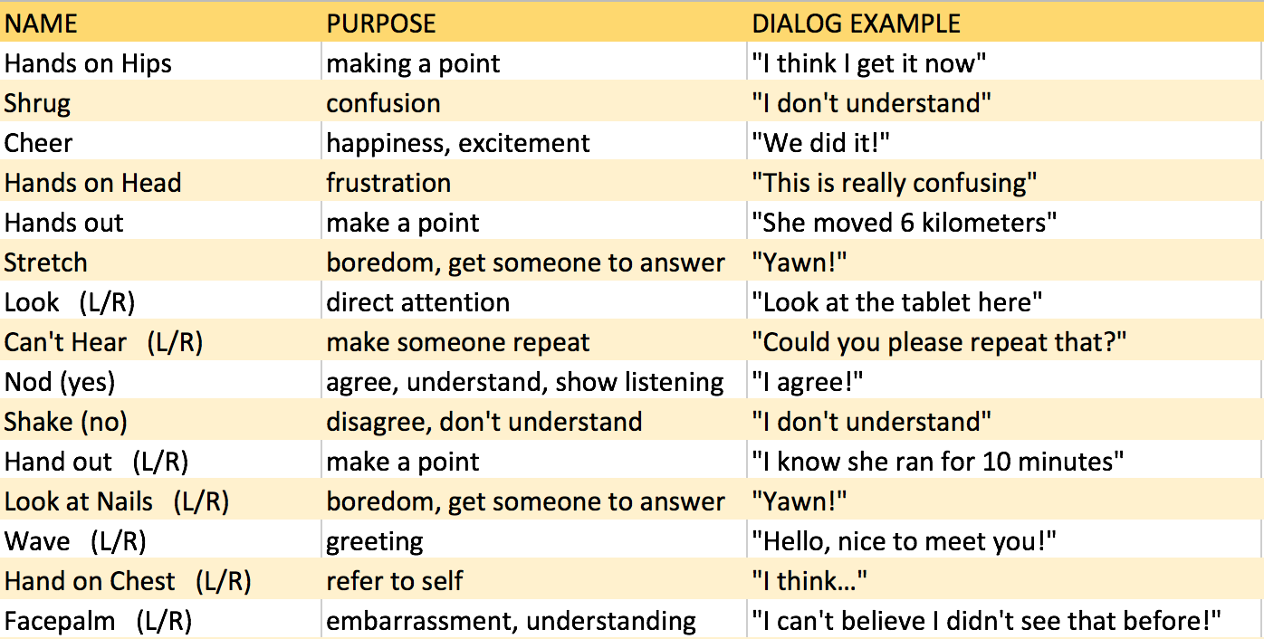
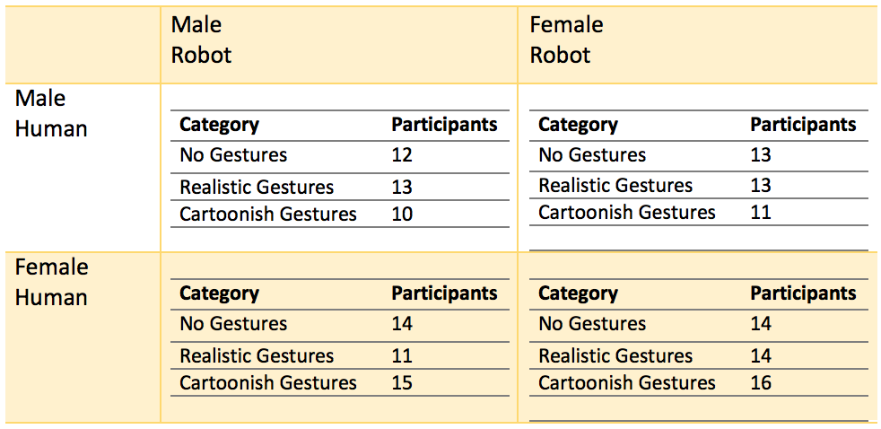
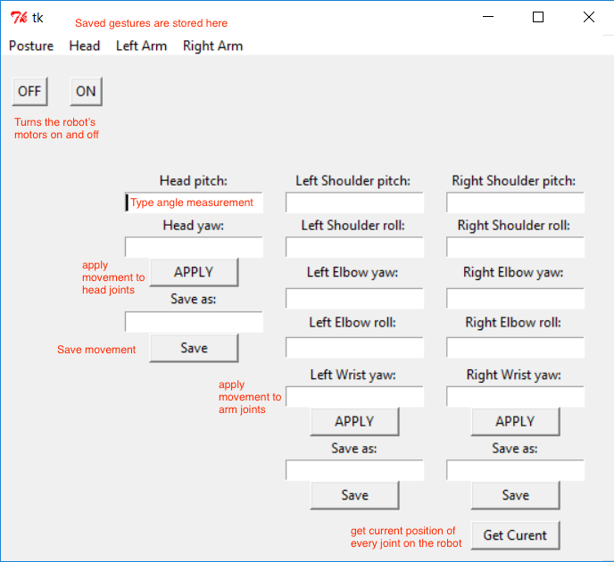
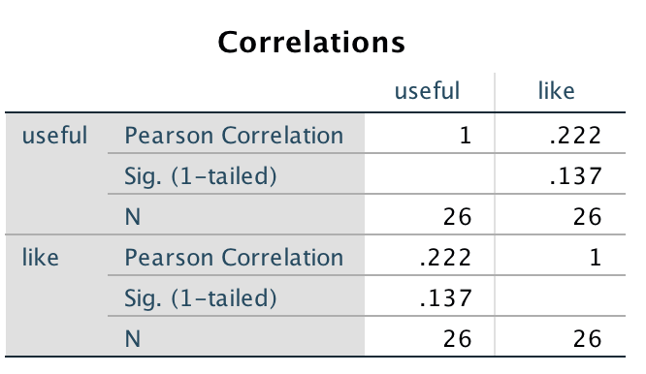
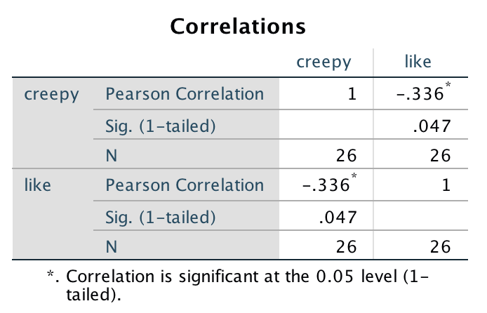
THE IMPACT OF GESTURES ON PERCEPTIONS OF A HUMANOID ROBOT
Samantha Baker, Informatics
Mentor: Dr. Erin Walker, Assistant Professor
School of Computing, Informatics, & Decision Systems Engineering
Research questions: Does changing the style of gestures performed by a humanoid robot result in different perceptions of the robot’s friendliness and humanlike qualities? Does the perceived gender of the robot impact those perceptions?
Motivation
Emblematic Gestures
These are the final gestures included in the study. They do not represent the total gesture catalog.
Mechanical Turk Study
I asked participants to rate their opinions on humanoid robots, then watch a short video of the NAO performing some gestures. They then rated the robot on 5 scales:
Like - Dislike, Friendly - Unfriendly, Lifelike - Cartoonish, Elegant - Rigid, and Humanlike – Machinelike.
The public has mixed views on the usefulness and likeability of humanoid robots. A surprising number of people are openly reluctant or hostile to the idea of interacting with one. Can people’s negative perceptions of a humanoid robot be mitigated by tailoring its nonverbal communication? And do certain styles of movement convey friendliness and humanlike qualities better than others?
Gesture Implementation
Python application
TKinter GUI
NAO API allows for angle interpolation using degrees or radians in every joint
Hypotheses
H1: Participants who reported feeling comfortable interacting with humanoid robots will like the robot more than those who didn’t.
H2: Participants who reported finding humanoid robots creepy will like the robot less than those who didn’t.
H3: There will be no significant difference between male and female participants’ perceptions of the robot.
H4: Participants who saw the cartoonish gestures will find the robot more friendly than participants who saw the realistic gestures or null case.
H5: Participants who saw the null case will find the robot more elegant than participants who saw the realistic gestures or cartoonish gestures.
H6: Participants who saw the realistic gestures will find the robot more humanlike than participants who saw the null case or cartoonish gestures.
Preliminary Results and Contributions
At this point only the results for the first 155 participants are available for analysis.
H1:
H2:
The current functionality allows for users to create, test, and save simple gestures composed of one or several joints moving in tandem. I used it to prototype, but I created the final gestures by coding directly in Python.
In the future, I’d like to expand this applet to support the creation of multi-phase gestures like the ones I used in my study.
This study will inform the style of gestures chosen for future NAO robot pilots and studies. The gestures that cause the robot to be received the most positively can be reused for future studies using the NAO robot at ASU and the Python tool will be useful for further gesture development.

